Slide 1
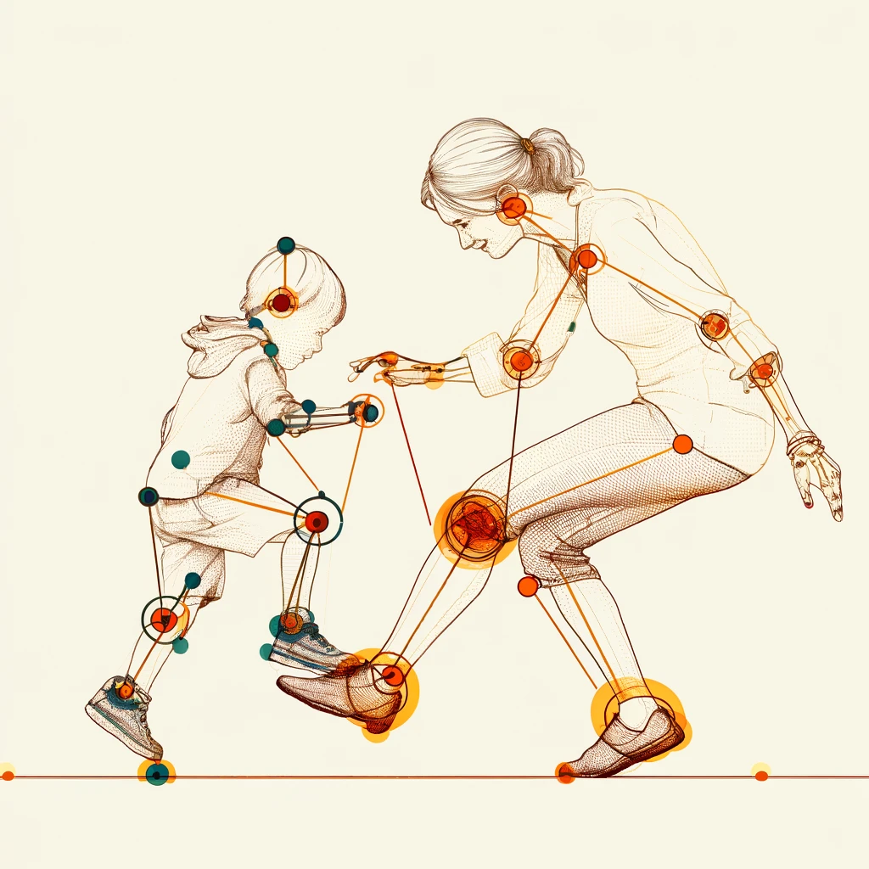
Evaluation of Interpersonal Synchronization between Individuals based on Video Recording
Final Project presentation
Stage A
Dana Betesh 315015958
Semion Rodman 319636395

Slide 2

Interpersonal Synchrony
Coordination of behaviors, emotions, physiological responses between individuals
Essential for social bonding, effective communication
Valuable for understanding the coordination of behavioral and physiological rhythms between individuals
People walking in sync: Example of spontaneous Interpersonal Synchrony

Slide 3
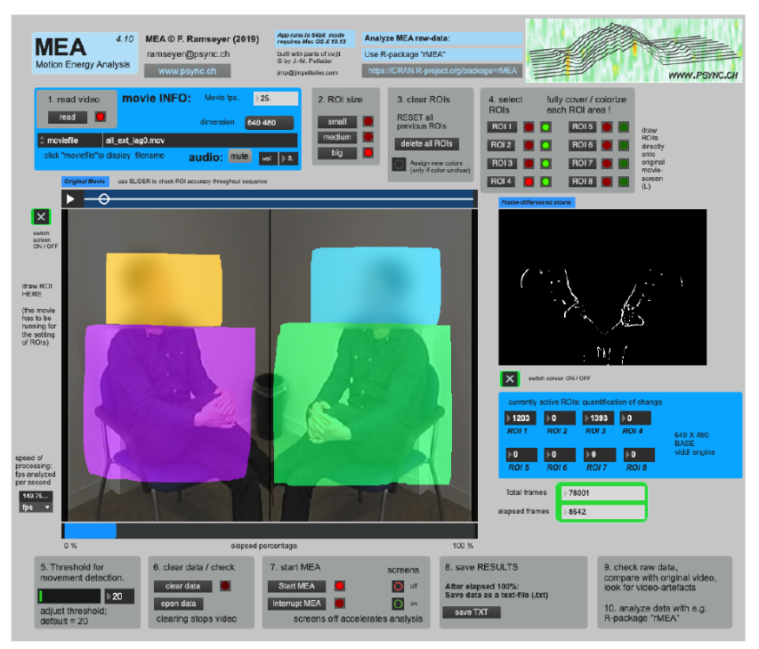
Challenges in current measurement methods
MEA (Motion Energy Analysis) frame-differencing algorithm that measures the differences between consecutive frames in a video recording
2D recordings limit depth and accuracy
Overlapping actions obscure individual movements
Ramseyer, F. T. (2020). Motion energy analysis (MEA): A primer on the assessment of motion from video. Journal of counseling psychology, 67(4), 536

Slide 4
Requirements for a new solution
Accurate pose detection in dynamic settings, to ensure the captured data reflects true motion dynamics – for reliable analysis
Handling occlusions and partial overlaps – reconstruction of movement for hidden or partially visible body parts. Needed to ensure tracking of movements when subjects interact closely or obstruct each other

Slide 5
Proposed solution - Technical Approach
Use of video recordings for data collection
Machine learning for pose landmark detection, making use of the recent advancements in the field
Analysis based on the similarity of motion vectors instead of a pixel-based, frame-by-frame method

Slide 6
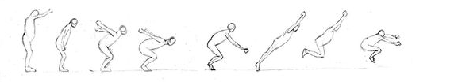
Keyframes
“Keyframe” - frame in a video that marks significant changes within a video sequence. Using keyframes will allow us to translate continues movement into series of discrete segments
PeakUtils python package that provides peak detection functions - peak estimation based on frame difference which will be calculated based on pixel values between frames

Slide 7
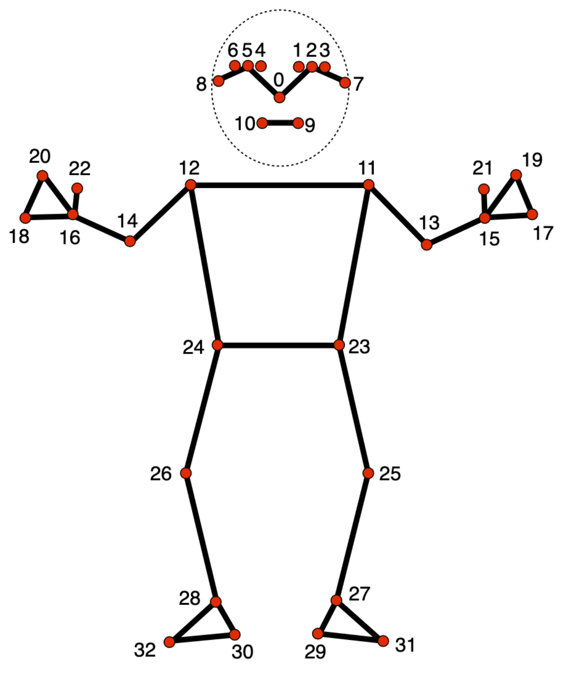
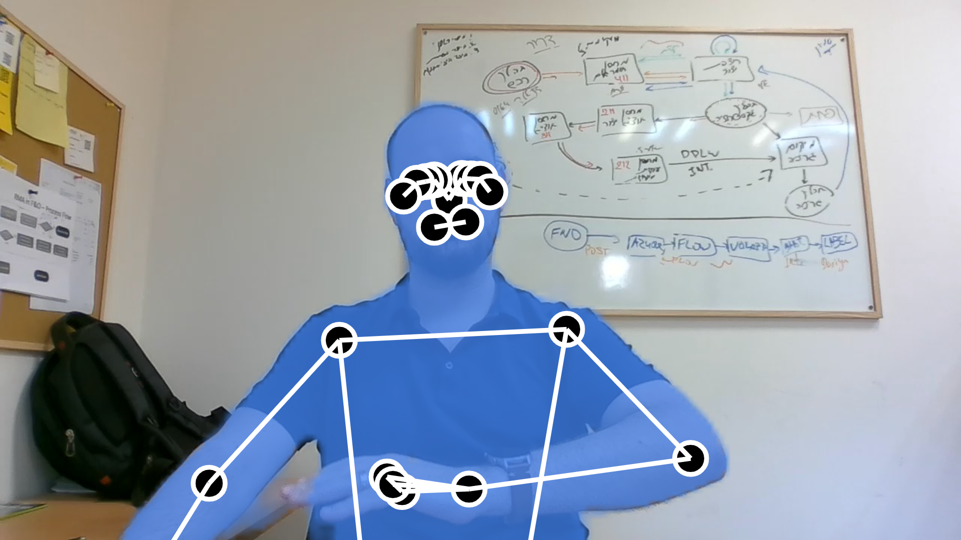
Pose Detection and Body Landmarks
MediaPipe framework + MediaPipe Pose Landmarker task
Open-source software project by Google
Real-time, accurate pose estimation using ML, with detection of up to 32 key points on the human body in glorious 3D ( x, y, z coordinates)
Support for Python 🐍
https://ai.google.dev/edge/mediapipe/solutions/vision/pose_landmarker
Test run done on a student.
No students were harmed

Slide 8
Movement Vector calculation (?)
Extracting start and end points for movements from key frames, based on body landmarks detected
Vector normalization for accurate comparison between differently sized subjects
Reconstruction of overlapping movements using previous and subsequent frames
Last frame of the landmark before the overlap
First frame of the landmark after the overlap
Can be though of as ‘keyframes’

Slide 9
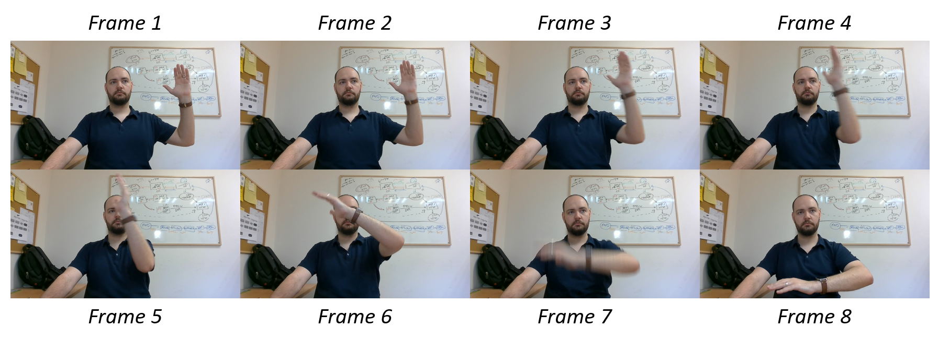
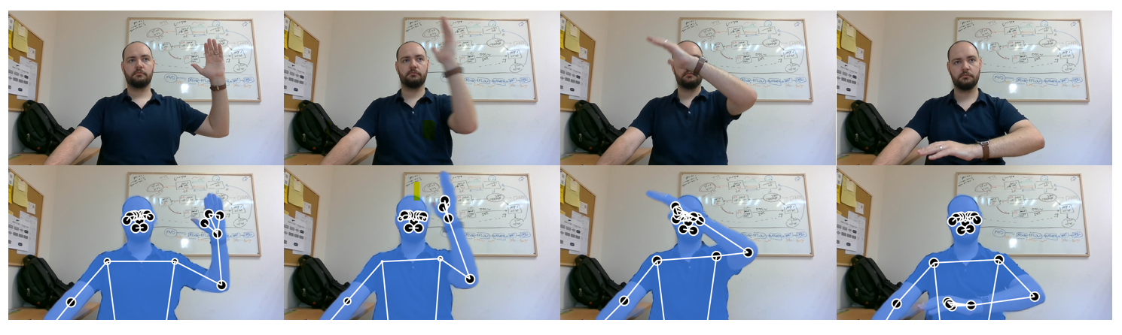
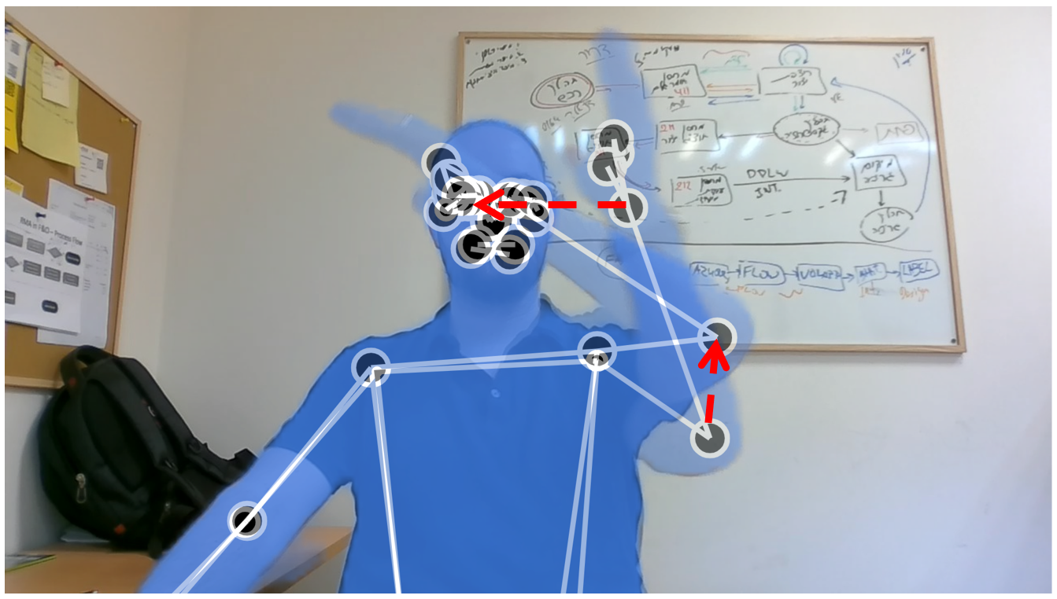
The Pipeline
Video of a motion
Keyframes extraction using PeakUtils
Body landmark detection using MediaPipe
Vector Calculation

Slide 10
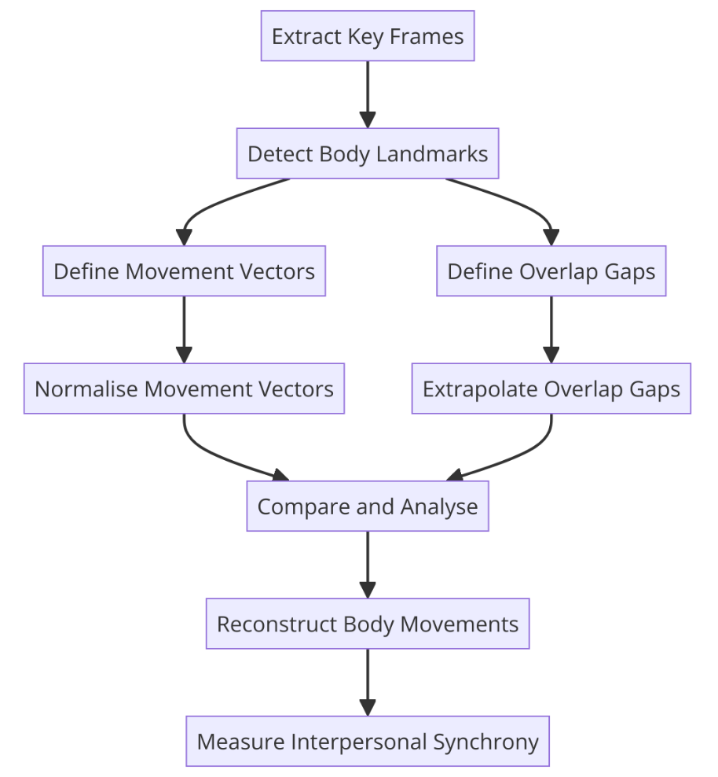
Algorithm overview
Finding and extracting key frames from the video
Start / End points of a major movement segments
Detection of body landmark locations using the MediaPipe ML library for body pose detection on the keyframes
Start / End points of overlaps
Calculation of vectors from movement keyframes
Extrapolation of vectors from start/end frames of the overlap
Building vector representations of body movement
Measuring IS using methodologies adapted from previous projects

Slide 11
IS Analysis Methods
Rolling-Window-Time-Lagged-Cross-Correlation (RWTLCC):
Correlation of time-shifted data streams
Effective for identifying synchrony with slight temporal misalignments
Dynamic Time Warping (DTW):
Non-linear alignment of vector sequences
Suitable for sequences with varying lengths and temporal offsets
Selection Criteria:
Preliminary tests to determine most suitable method

Slide 12
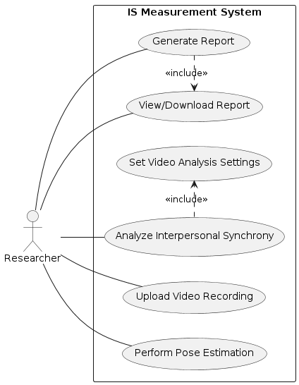
Product Use Case Diagram
General expected system functionality
Used as a basis for GUI planning
Used as basis for testing plans

Slide 13
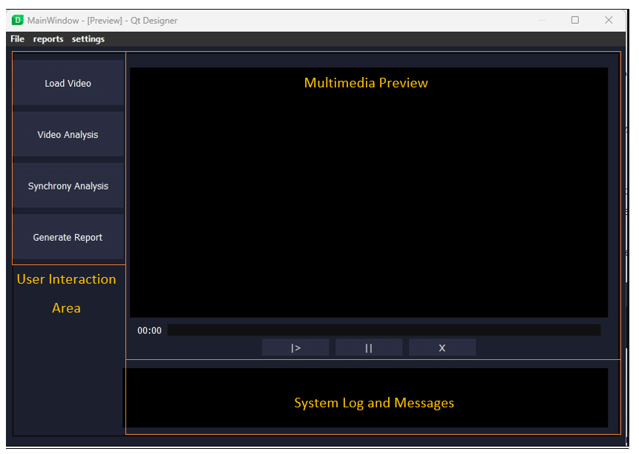
Expected Product
GUI created using Qt framework and PyQt bindings library
Ability to upload and preview video
Analysis settings configuration
Pose estimation and IS calculation
Report generation in PDF and CSV formats
GUI prototype created using Qt and Qt Designer software

Slide 14
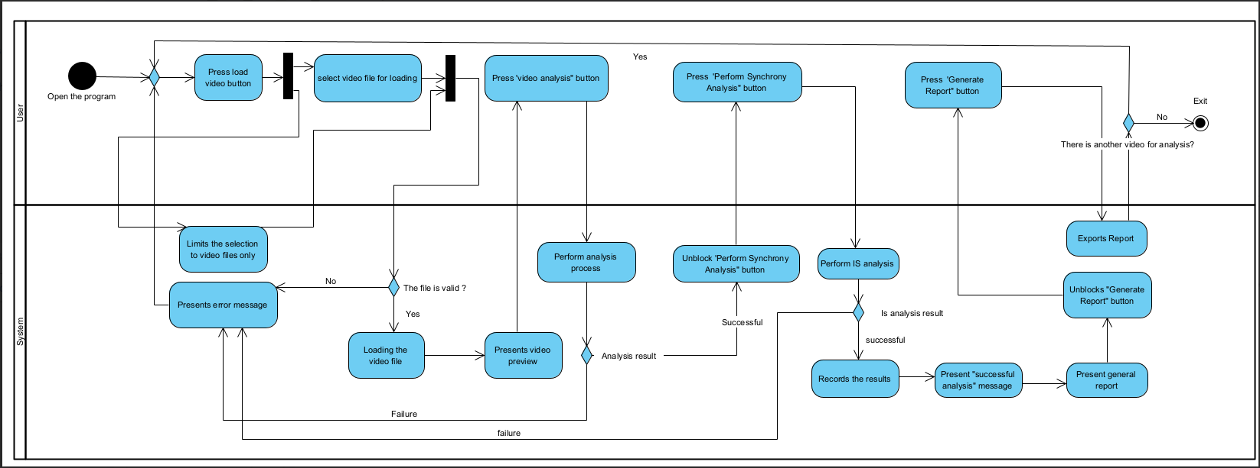
User Interaction – Activity Diagram

Slide 15
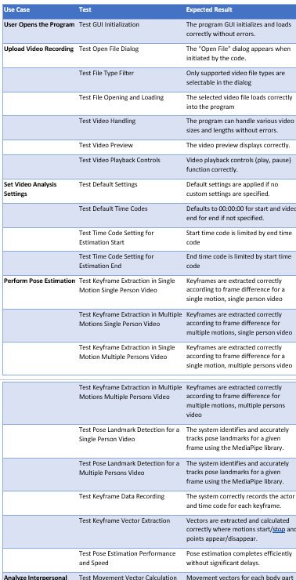
General Testing Plan overview
Functional Tests:
GUI initialization and operation
Video handling - loading, playback, and segmentation
Pose estimation accuracy
Reliability Tests:
Correctness of IS analysis
Error handling and user feedback
We promise – there are actually more tests planned!

Slide 16
Thanks!
Thanks!
Also – Q&A time

